Slide 1
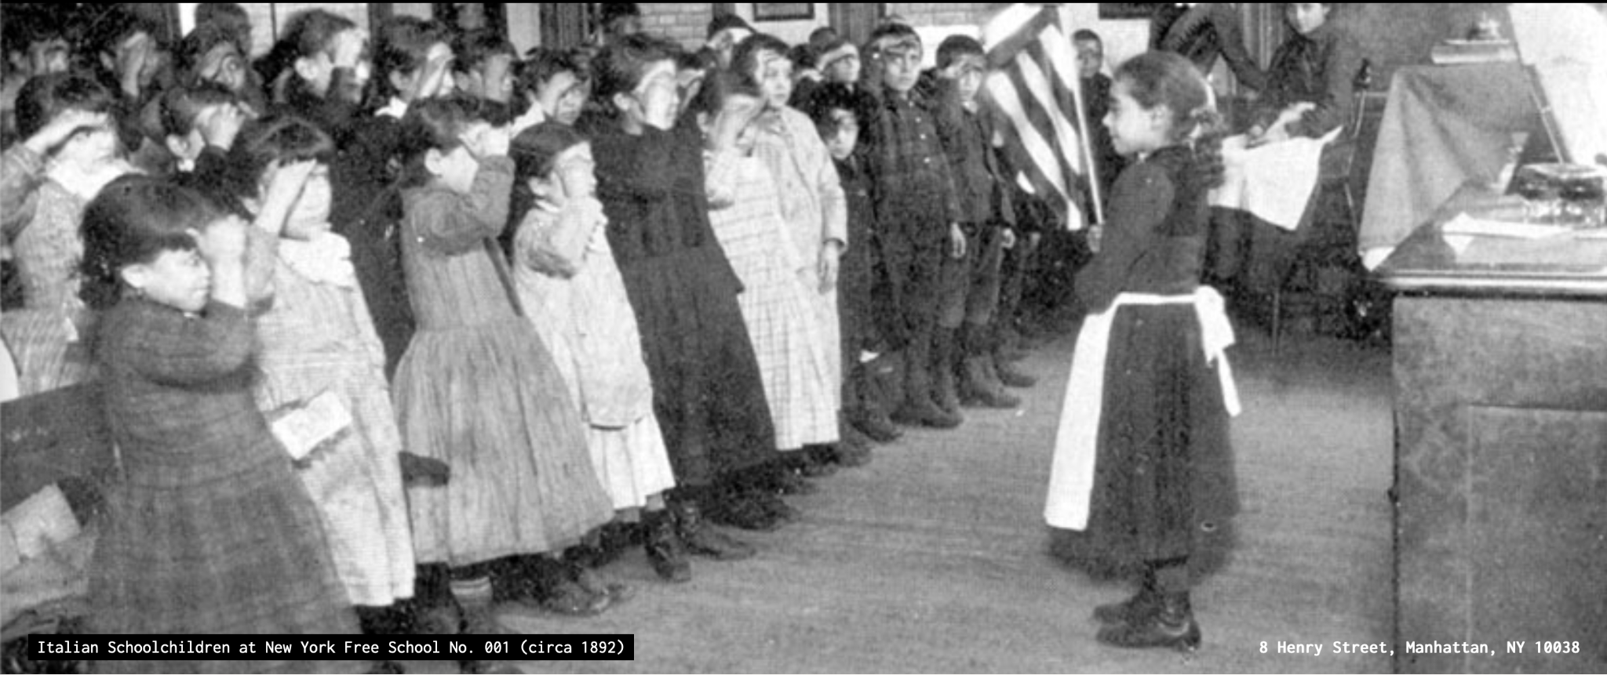
Common School Archive of New York State
Cen Liu,
Theatre & Performance
Zachary Muhlbauer,
English
Prototype:
https://zmuhls.github.io/CommonSchoolMap/

Slide 2
What is the Common School Movement?
Began with nineteenth-century ideal of free-of-charge common schooling governed by locally elected school boards
Ended with state-regulated education system attaining greater control over funding and educational standards
How does this historical narrative square with locally situated common schools?
In NYC alone:
  New York Free School No. 1
  New York African Free School No. 2
  Wadleigh High School for Girls
  Colored School No. 4
  Grammar School No. 9

Slide 3
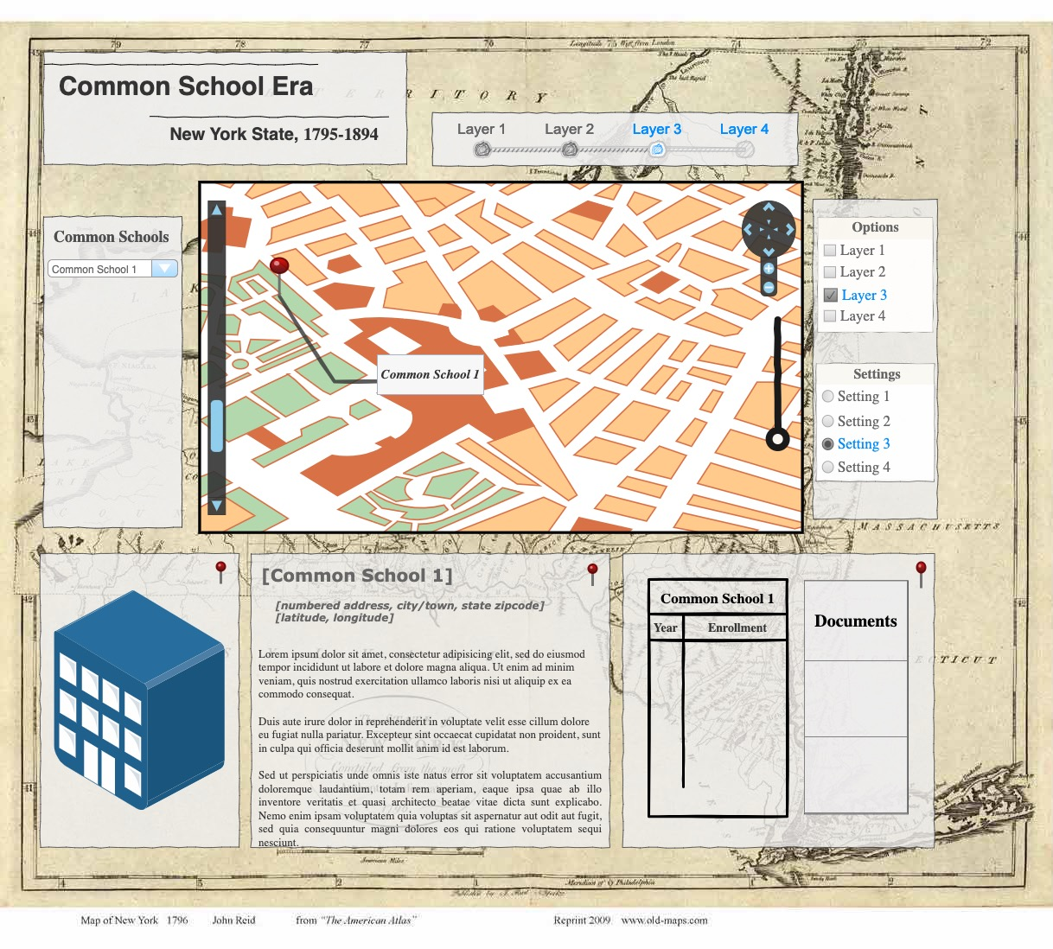

Slide 4
Archival Materials
New York State Archive — Albany, NY
Meeting Minutes (School District Board of Education)
Legal Files for the Establishment of School Districts (Department of Educational Finance)
Reports on Common Schools (Department of State County Clerk)
Kheel Center for Labor-Management Documentation and Archives — Cornell University Library
Annual NYSTA meeting proceedings and notes (the New York State Teachers Association)
The Library of Congress — Washington, D.C.
Report of the School Fund and of Taxation and Revenue of NYS Comptroller's office
Report of the Select Committee on the Petitions for the Amendment or Repeal of the Free School Law
Code of Public Instruction of the State of NY (laws and decisions relating to common schools)

